Slide 1

6th Grade Math
Unit 8, Lesson 4 Area of Composite Figures Volume 2, pg. 92

Slide 2


Benchmark
MA.6.GR.2.2
Solve mathematical and real-world problems involving the area of quadrilaterals and composite figures by decomposing them into triangles or rectangles.
volume 2, pg. 92

Slide 3
Integrated Mathematical Thinking and Reasoning Standards
MA.K12.MTR.1.1 Actively participate in effortful learning both individually and collectively.
MA.K12.MTR.2.1 Demonstrate understanding by representing problems in multiple ways.
MA.K12.MTR.3.1 Complete tasks with mathematical fluency.
MA.K12.MTR.4.1 Engage in discussions that reflect on the mathematical thinking of self and others.
MA.K12.MTR.5.1 Use patterns and structure to help understand and connect mathematical concepts.
volume 2, pg. 92

Slide 4

Learning Target
I can find the area of composite figures.
volume 2, pg. 92

Slide 5

Warm-Up
volume 2, pg. 93

Slide 6
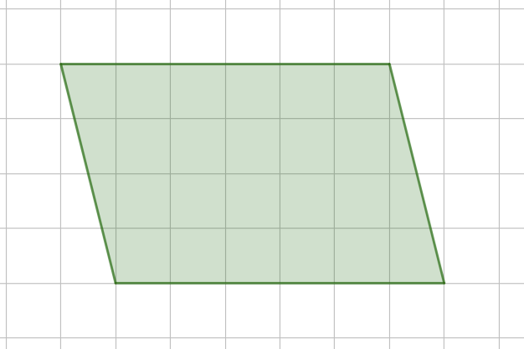
8.4.1 Warm-Up: Bell Work
In the figure, each square of the grid paper is 1 centimeter (cm) by 1 cm.
Find the area of the shaded region. Include units.
volume 2, pg. 93

Slide 7

Guided Instruction
volume 2, pg. 93

Slide 8

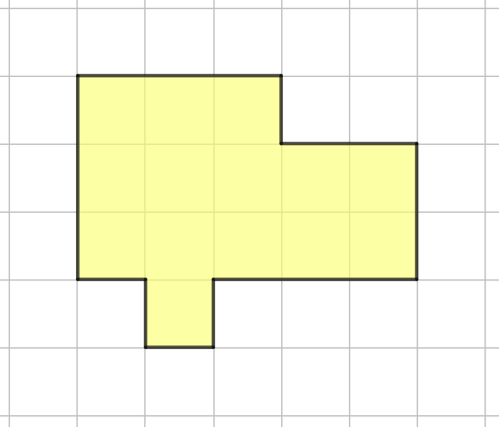
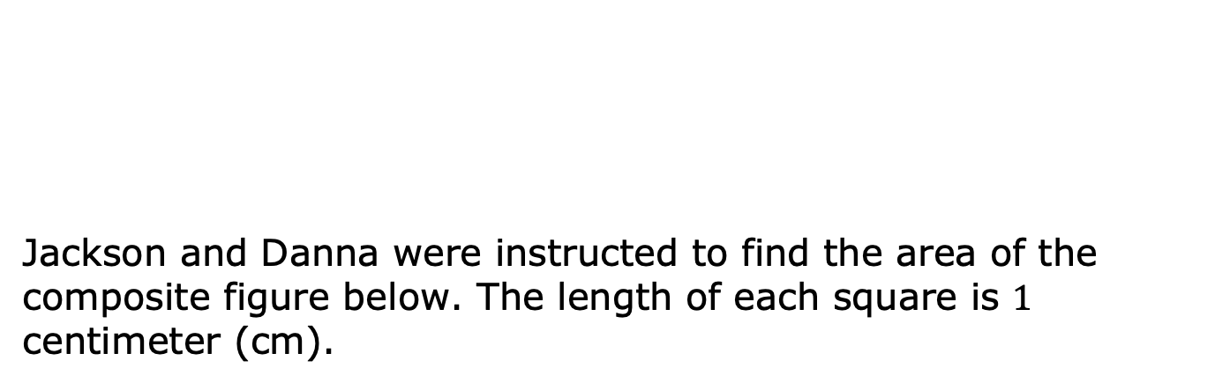
8.4.2 Guided Instruction: Area of Composite Figures
Jackson and Danna were instructed to find the area of the composite figure below. The length of each square is $1$ centimeter (cm).
A composite figure is a two- or three- dimensional figure that can be decomposed into smaller figures.
volume 2, pg. 93

Slide 9
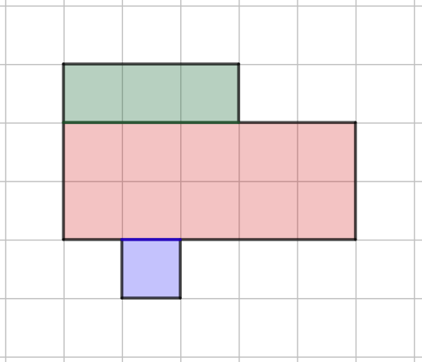
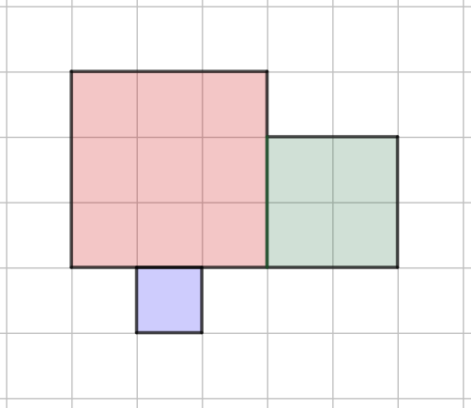
Both Jackson and Danna decomposed the figure, but their teacher noticed they each decomposed it differently.
Jackson
Danna
volume 2, pg. 93

Slide 10
Complete the table about each student’s work. Include units.
Student | Area of Red Rectangle | Area of Blue Rectangle | Area of Green Rectangle
Jackson
Danna
volume 2, pg. 94

Slide 11
To find the area of the composite figure, find the sum of the areas of the rectangles for each student. Include units.
 | Area of the Composite Figure
Jackson
Danna
volume 2, pg. 94

Slide 12

Explain why both students got the same area of the composite shape.
The area of a composite figure is the sum of the areas of the figure’s decomposed parts.
volume 2, pg. 94

Slide 13

Guided Practice
volume 2, pg. 94

Slide 14

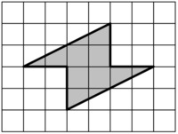

8.4.3 Guided Practice: Area of Composite Figures
A composite shape is shown. The length of each square is $1$ inch (in).
Draw lines to decompose the figure into rectangles and/or triangles.
volume 2, pg. 94

Slide 15
Find the area of each rectangle and/or triangle. Include units.
Find the sum of the areas of the rectangles and/or triangles to find the area of the composite figure. Include units.
Find a classmate who decomposed the shape differently than you did. Describe their process.
volume 2, pg. 94

Slide 16
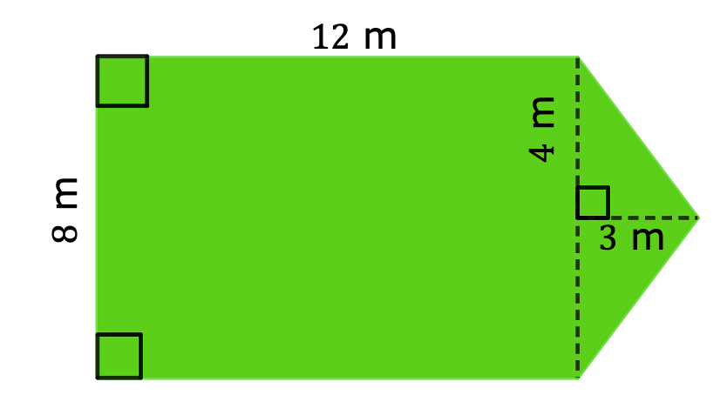
Thomas has decided to put grass sod in his backyard. A drawing of his backyard is shown.
How much sod does Thomas need to buy?
volume 2, pg. 95

Slide 17

Your Turn
volume 2, pg. 95

Slide 18
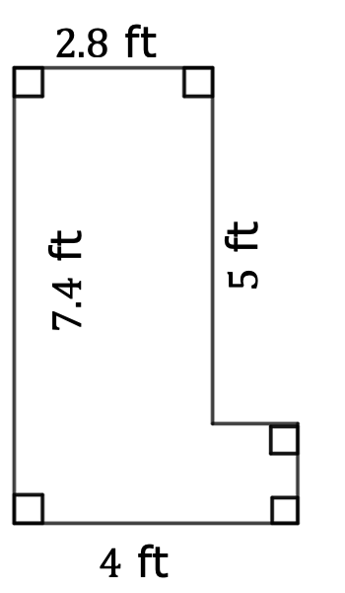
8.4.4 Your Turn!
For each composite figure, find the area, in square feet (ft²). Show your work.
Area = ____________
volume 2, pg. 95

Slide 19
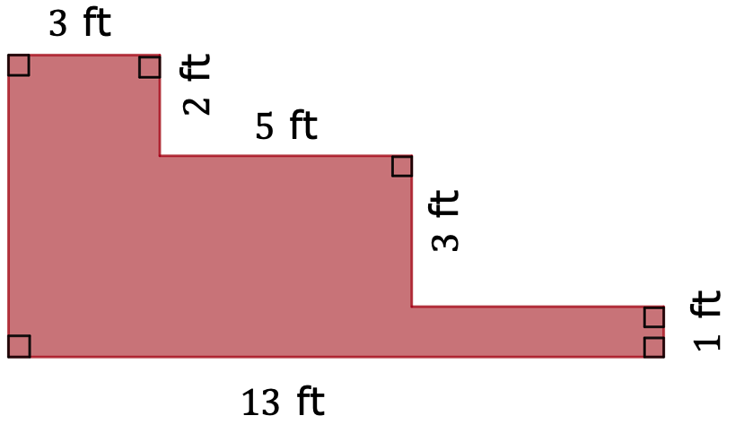
Area = ____________
volume 2, pg. 95

Slide 20
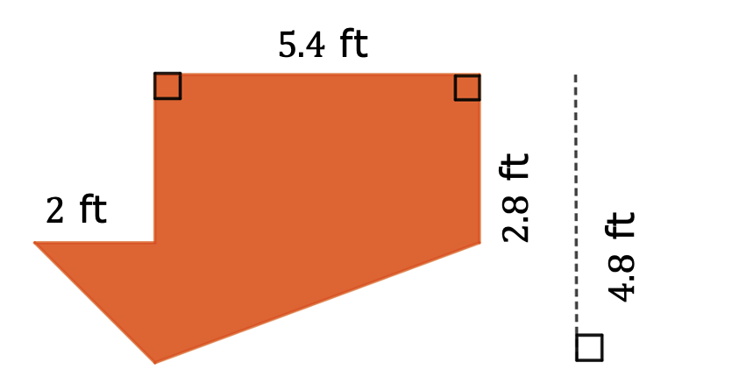
Area = ____________
volume 2, pg. 96

Slide 21

Wrap-Up
volume 2, pg. 96

Slide 22
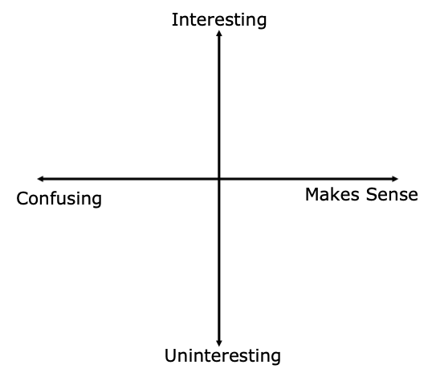
8.4.5 Wrap-Up: Reflection
Plot a point in one of the quadrants below to indicate how you feel about today’s learning target: “I can find the area of composite figures.”
volume 2, pg. 96

